Slide 1
Why I’m Building a Self-Sufficient Home in Perth
Angad Pfuetzner

Slide 2
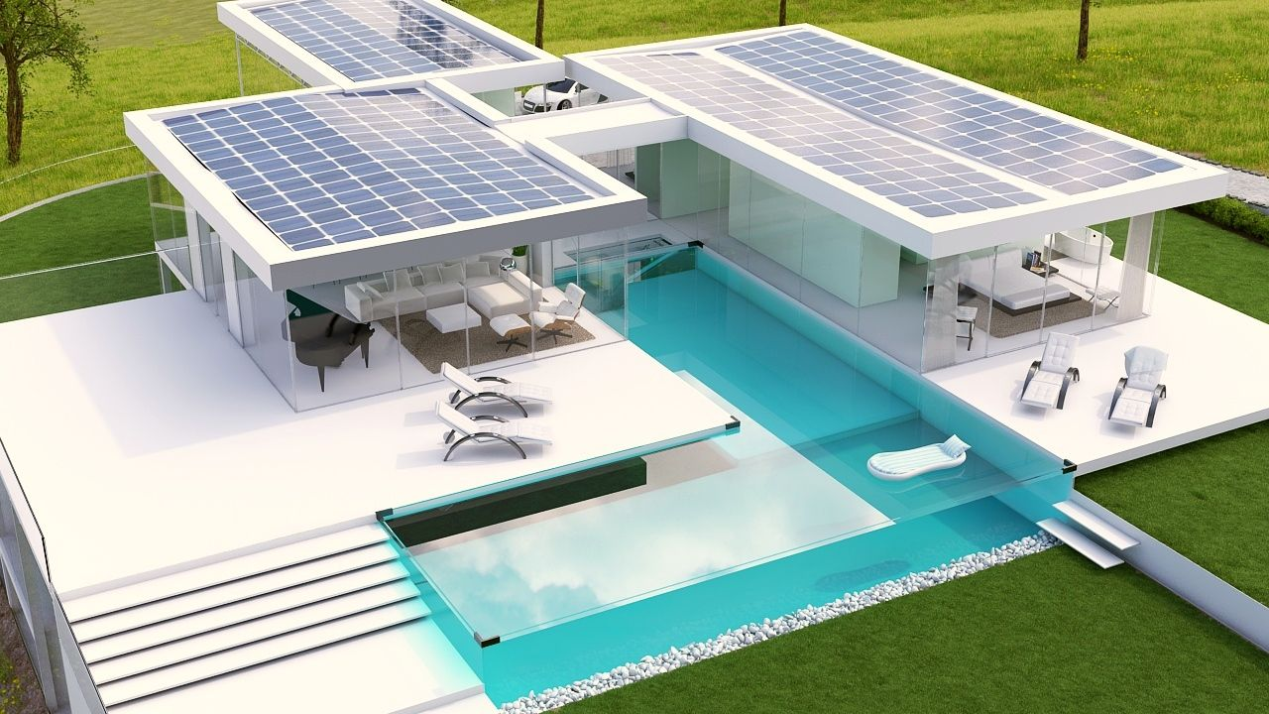

Slide 3


Requirements
>8 hrs sun/day
Population > 500 000

Slide 4
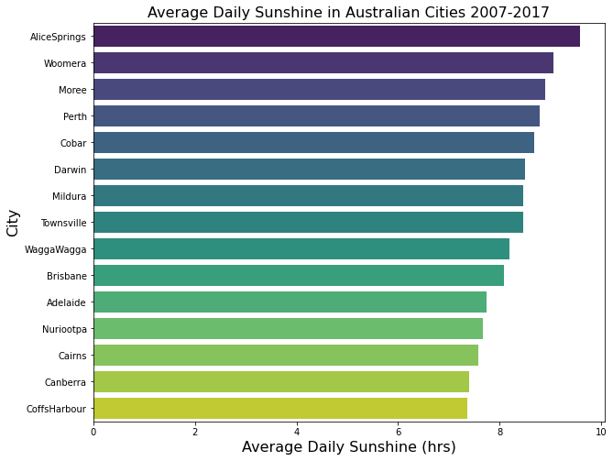

Slide 6
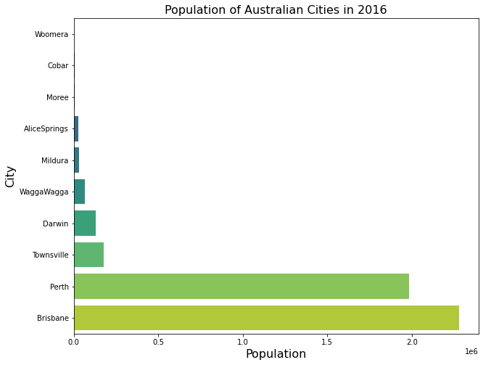

Slide 7
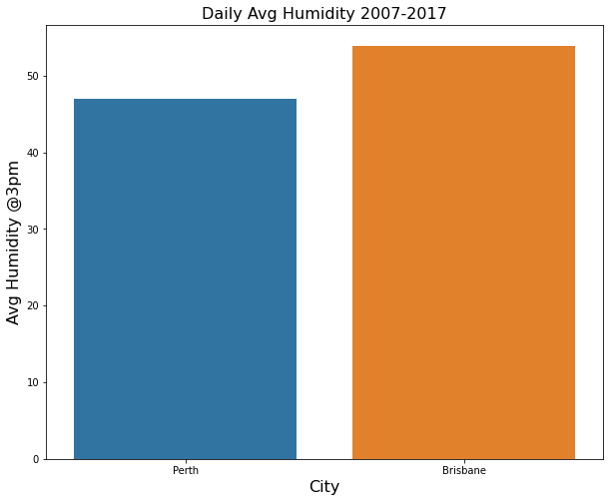

Slide 8
